Slide 1
ROS installation and basics
19AIE213 - Robot Operating System and Robot Simulation

Slide 2
Previous Section
Course Overview
ROS - Definition
ROS - History
ROS - Philosophy
Why ROS ?
ROS Robots
Distributions of ROS

Slide 3
Section Overview
ROS Installation
Robot Process Cycle
ROS Architecture
ROS Basics
Simple ROS Application Example
Creating a ROS Workspace
ROS File System
Creating ROS Package

Slide 4
ROS Installation
We will be using the latest stable ROS2 "Humble HawksBill" full desktop version in this course
This can be only installed in Ubuntu 22:04 LTS
The steps mentioned are from https://docs.ros.org/en/humble/Installation/Ubuntu-Install-Debians.html

Slide 5
ROS Installation
Set locale
locale # check for UTF-8
sudo apt update && sudo apt install locales
sudo locale-gen en_US en_US.UTF-8
sudo update-locale LC_ALL=en_US.UTF-8 LANG=en_US.UTF-8
export LANG=en_US.UTF-8
locale # verify settings
Setup Sources
sudo apt install software-properties-common
sudo add-apt-repository universe
sudo apt update && sudo apt install curl
sudo curl -sSL https://raw.githubusercontent.com/ros/rosdistro/master/ros.key -o /usr/share/keyrings/ros-archive-keyring.gpg
echo "deb [arch=$(dpkg --print-architecture) signed-by=/usr/share/keyrings/ros-archive-keyring.gpg] http://packages.ros.org/ros2/ubuntu $(. /etc/os-release && echo $UBUNTU_CODENAME) main" | sudo tee /etc/apt/sources.list.d/ros2.list > /dev/null

Slide 6
ROS Installation
Installation
sudo apt update
sudo apt upgrade
sudo apt install ros-humble-desktop
Environment setup
echo "source /opt/ros/humble/setup.bash" >> ~/.bashrc
source ~/.bashrc

Slide 7
ROS Installation Verification
Run Talker-Listner example
ros2 run demo_nodes_py talker
In an new terminal enter the below command
ros2 run demo_nodes_py listener
The can be done with cpp as well

Slide 8
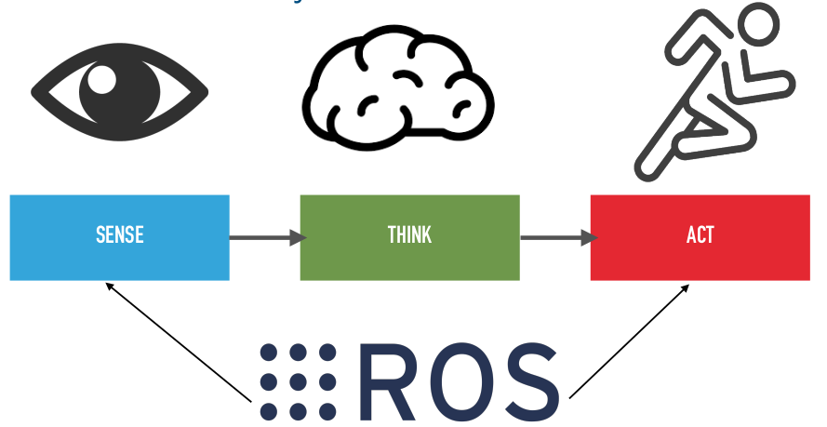
Robot Process Cycle
Image Courtesy: Prof. Anis koubaa

Slide 9
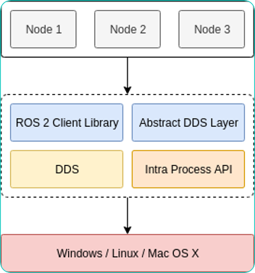
ROS Architecture
Image Courtesy: Prof. Anis koubaa

Slide 10
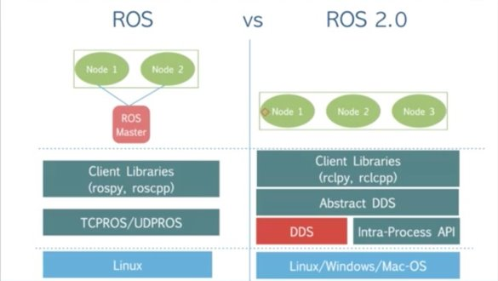
ROS1 vs ROS2
Image Courtesy: Prof. Anis koubaa

Slide 11
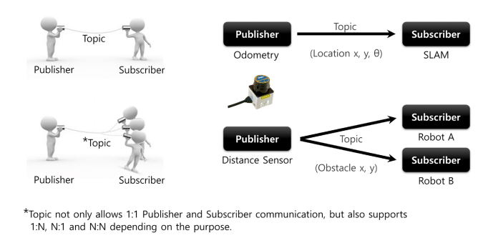
ROS BAsics – Publisher/Subscriber
Image Courtesy: Prof. Anis koubaa

Slide 12
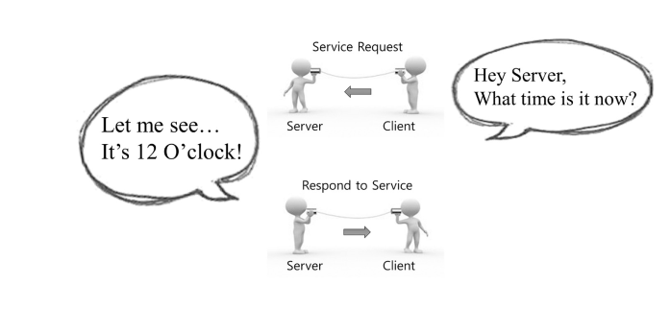
ROS Basics - Services
Image Courtesy: Prof. Anis koubaa

Slide 13
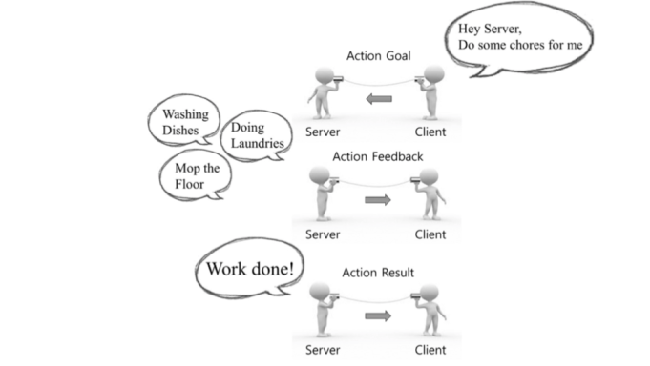
ROS Basics - Actionlib
Image Courtesy: Prof. Anis koubaa

Slide 14
Simple ROS Application Example
Running a simple teleoperated robot example
Sequence of commands
In a new terminal - ros2 run turtlesim turtlesim_node //This will start a node
In a new terminal - ros2 run turtlesim turtle_teleop_key //This will start a node
Now by keeping this terminal active and pressing the arrow keys the turtle will move accordingly

Slide 15
SIMPLE ROS APPLICATION EXAMPLE
Other commands to try
ros2 node list // list all the nodes running
ros2 topic list // list all the topic published by the current nodes
ros2 topic info "topic name" // prints the details of the "topic name"
ros2 interface show "message type" // prints the details of a "message type"
ros2 topic echo "topic name" // stream the date published by "topic name"
ros2 topic pub "topic name" "msg_type" "args" //publishes data on the "topic name"
rqt_graph //Prints a graph of the current nodes with their connections

Slide 16
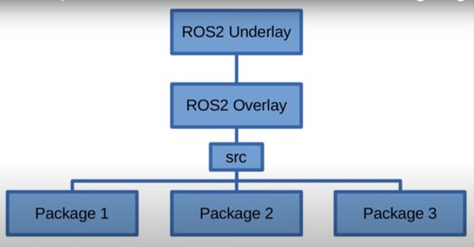
ROS File System Organization

Slide 17
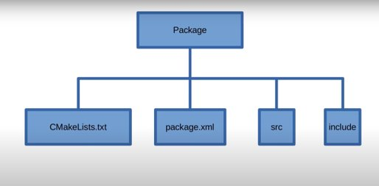
ROS FILE SYSTEM ORGANIZATION

Slide 18
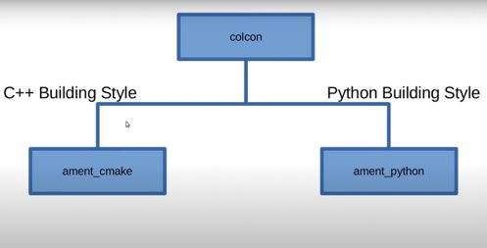
ROS FILE SYSTEM ORGANIZATION

Slide 19
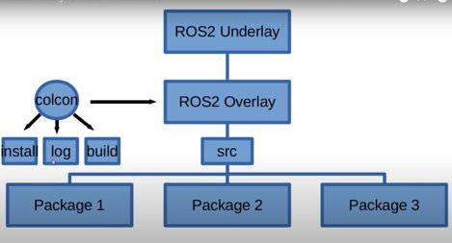
ROS FILE SYSTEM ORGANIZATION

Slide 20
Creating ROS Workspace
A ROS workspace is a directory with a particular structure. It is build using "colcon" tool
Commonly there is a "src" subdirectory. Inside that subdirectory is where the source code of ROS packages will be located. Typically the directory starts otherwise empty.
By default it will create the following directories as peers of the src directory:
The "build" directory will be where intermediate files are stored. For each package a subfolder will be created in which e.g. CMake is being invoked.
The "install" directory is where each package will be installed to. By default each package will be installed into a separate subdirectory.
The "log" directory contains various logging information about each colcon invocation.

Slide 21
Creating ROS Workspace
First, create a directory (ros2_ws) to contain our workspace
mkdir -p ~/ros2_course_ws/src
cd ~/ros2_course_ws
We call this workspace as an "overlay", ROS environment is an "Underlay". We can have multiple overlays.
To build the workspace be in the root of the workspace and run
colcon build --symlink-install
After the build is finished, we should see the build, install, and log directories:
Source the setup.bash file which is in install directory to link the path to your workspace. Append this line in your bashrc file :
source /home/nippun/ros2_course_ws/install/setup.bash

Slide 22
Creating ROS Workspace
The command colcon_cd allows you to quickly change the current working directory of your shell to the root of your workspace
To enable that add the following lines in the bashrc file
source /usr/share/colcon_cd/function/colcon_cd.sh
export _colcon_cd_root=/home/nippun/ros2_course_ws/
The command colcon supports command completion for bash and bash-like shells if the colcon-argcomplete package is installed. Add the following line in bashrc
source /usr/share/colcon_argcomplete/hook/colcon-argcomplete.bash
Don't forget to source your bashrc file for the changes to be effective
source ~/.bashrc

Slide 23
Creating A Package
A package can be considered a container for your ROS 2 code. If you want to be able to install your code or share it with others, then you’ll need it organized in a package. With packages, you can release your ROS 2 work and allow others to build and use it easily.
Package creation in ROS 2 uses ament as its build system and colcon as its build tool. You can create a package using either CMake or Python, which are officially supported, though other build types do exist.

Slide 24
Creating A Package
ROS 2 Python and CMake packages each have their own minimum required contents:
Cmake
package.xml file containing meta information about the package
CMakeLists.txt file that describes how to build the code within the package
Python
package.xml file containing meta information about the package
setup.py containing instructions for how to install the package
setup.cfg is required when a package has executables, so ros2 run can find them
/<package_name> - a directory with the same name as your package, used by ROS 2 tools to find your package, contains __init__.py

Slide 25
Creating A Package
Go inside the src folder of the overlay and type the following command
ros2 pkg create --build-type ament_python <package_name>
After adding the required source files the package have to be built
colcon build
Command for building specific package:colcon build --packages-select <Package_name>

Slide 26
Creating Hello World Package
Run the following commands in sequence
In the /ros2_course_ws/src ros2 pkg create --build-type ament_python my_first_package
Create a python file named "my_node.py" in my_first_package/my_first_package

Slide 27
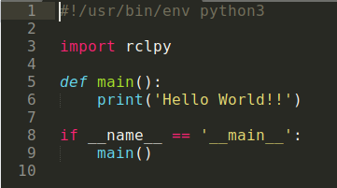
My_First_Package.py
Command to run your code: ros2 run my_first_package my_node

Slide 28
Thank You !!!
Course Repository: https://github.com/NippunKumaar/ROS2-Course.git

